Slide 1


Çankaya unıversıty computer engıneerıng department ceng 408 - Innovative System Design and Development II
I-NGOS
Intelligent Non-Governmental Organizations’ Management System
Project Advisor : Prof.Dr. Müslim BOZYİĞİT
Co-Advisor : Dr. Ulaş GÜLEÇ
NGO : İLKYAR
Team Members : Gizem ULUĞ - 201312066
Özge KÖKTÜRK - 201312046
Date : 11.06.2019

Slide 2
CONTENT
I-NGOS PROJECT DESCRIPTION
COMPANY INFORMATION
PROBLEM STATEMENT
ANALYSIS - LR & SRS
SOLUTION - SDD
FUTURE WORKS
CONCLUSION
REFERENCES

Slide 3
I-NGOS PROJECT DESCRIPTION
The aim is to develop an intelligent NGO (Non-Governmental Organization) management system.
A N-Tier Architecture (server-client) in the form of a cloud service.
Different user interfaces.
The system is expected to learn from every project to become more intelligent.
Client should be able to use the system on Web with responsive design.
İLKYAR (İlköğretim Okullarına Yardım Vakfı) is taken as a case NGO.

Slide 4

COMPANY INFORMATION
www.ilkyar.org.tr
İlköğretim Okullarına Yardım Vakfı
Established in Turkey in 1998.
Management Side
Arranges projects, visits schools, conduct activities, send materials, etc.
School Side
Hosts İLKYAR, gives sufficient information.

Slide 5
PROBLEM STATEMENT
Inavailability of a unique application that collects:
Project management tools
User management tools
Data management tools
Communication management tools and etc. together.
Project activities and schedules cannot be managed systematically.
Volunteering functions are not be arranged due to complexity.
Archieve records are not be used efficiently.
Feedbacks are not taken continuously.

Slide 6
LITERATURE REVIEW
COMPARISON OF NGOS

Slide 7
COMPARISON OF NGOS
Functions | Compassion | World Education | MEV | TEV | TED | AÇEV | ÇYDD | ÇEV | İLKYAR
1 | ✓ | ✓ | ✓ | ✓ | ✓ | ✓ | ✓ | ✓ | ✓
2 | ✓ | X | X | X | X | X | X | X | ✓
3 | X | ✓ | X | ✓ | X | ✓ | ✓ | ✓ | ✓
4 | ✓ | X | X | X | X | X | X | X | X
5 | ✓ | X | X | X | X | X | X | ✓ | X
6 | ✓ | ✓ | ✓ | ✓ | ✓ | ✓ | ✓ | ✓ | X
7 | ✓ | X | X | X | X | X | X | X | X
8 | ✓ | ✓ | ✓ | ✓ | ✓ | X | X | ✓ | X
9 | ✓ | X | X | X | X | ✓ | X | X | X
10 | ✓ | ✓ | ✓ | ✓ | ✓ | ✓ | ✓ | ✓ | ✓
11 | X | ✓ | X | X | X | X | X | ✓ | ✓
12 | X | X | X | X | X | X | X | X | X
1. Online surfing without login | 5. Feedback mechanisms | 9. Online purchase availability | • There exists no application. ✓ There exists the function. X The function does not exist.
2. Entry with user login | 6. Payment systems | 10. Separation of donation type
3. Being a volunteer choice | 7. Blog existence | 11. List of completed projects
4. Pop-ups usage | 8. Social media usage | 12. Scoring

Slide 8
SOFTWARE REQUIEREMENTS SPECIFICATIONS
ACTORS
REQUIREMENTS SPECIFICATION

Slide 9
ACTORS
NGO Head
Project Manager
Scholarship Committee
Yön-Der
Scholarship Holder
Volunteer
Schoolmaster
Host School Teacher
Student

Slide 10
REQUIREMENTS SPECIFICATION (External Interface Requirements)
User Interfaces
The user interface is decided as it will be performed on Web responsively.
Hardware Interfaces
The system requires any computer, smartphone or tablet which have internet connection.
Software Interfaces
No external software interfaces are required.
Communications Interfaces
No external communications interfaces are required.
Functional Requirements
Functional requirements are examined via use cases in CENG 407 Innovative System Design and Development I concept.
Performance Requirement
I-NGO Project aims to support at least 50 users’ usage simultaneously without any error occurred.

Slide 11
SOFTWARE DESIGN & IMPLEMENTATION
CENG 408 WORKPLAN
DATABASE DIAGRAM
I-NGOS INTERFACES
GAMIFICATION
TEST CASES
ENVIRONMENT
FUTURE WORK
CONCLUSION
PROJECT SUPPORTS AND PLANS
DEMO VIDEO

Slide 12
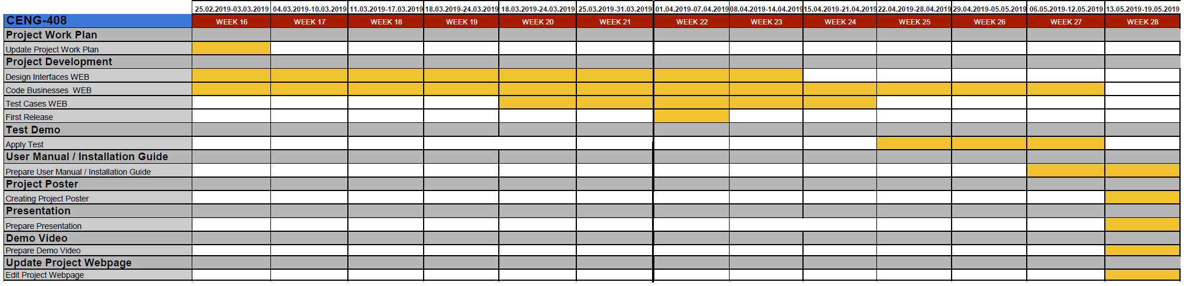
CENG 408 WORKPLAN

Slide 13
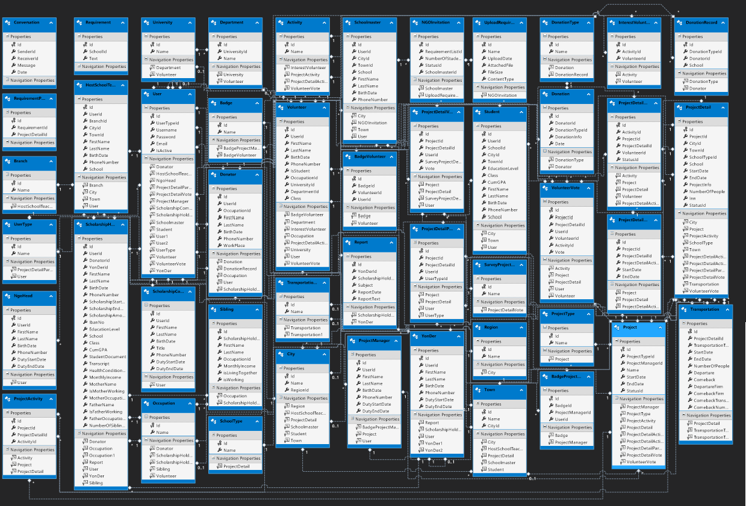
DATABASE DIAGRAM

Slide 14
I-NGOS INTERFACES
Account
Login and Logout, the registration procedures and the session parameters
Message
Sender / receiver functionalities, date & time information of the message sent or received
Profile
Displaying profile information of the current user
Project
Report
Creating a project, updating projects, displaying project details, evaluating projects
User
Yön-Der writes reports about Scholarship Holder
NGO Head and Yön-Der display the reports.
Listing, adding users and filtering them are provided.
Updates his/her profile information

Slide 15
INTELLIGENCE APPLICATIONS (Project Suggestion)
Volunteer interests
INTELLIGENT MODULE FOR PROJECT SUGGESTION
(The system analyzes the volunteer’s interests and the activities of newly created project details and tries to find out the most suitable matches as a suggestion to the volunteer.)
Activities of new created project details
Project suggestions
Interest and activity match ratio

Slide 16
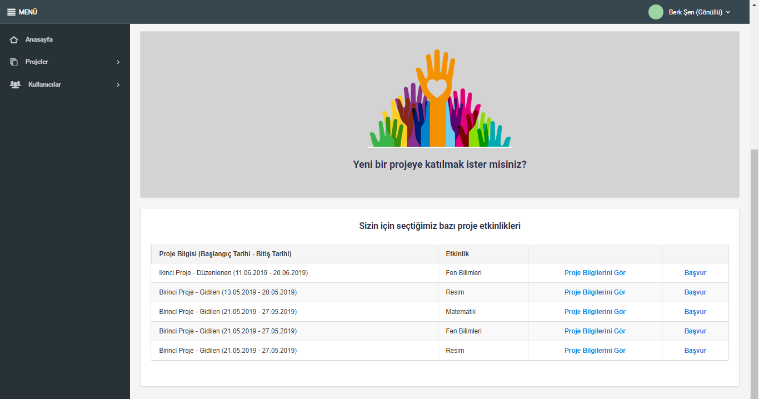
INTELLIGENCE APPLICATIONS (Project Suggestion)

Slide 17
INTELLIGENCE APPLICATIONS (Volunteer Suggestion)
Cities
INTELLIGENT MODULE FOR VOLUNTEER SUGGESTION
(The system analyzes the volunteer’s interests and the activities of newly created project details and tries to find out the most suitable matches as a suggestion to the project manager.)
Regions
School types
Volunteer suggestion
Project types
Number of activities
Number of people

Slide 18
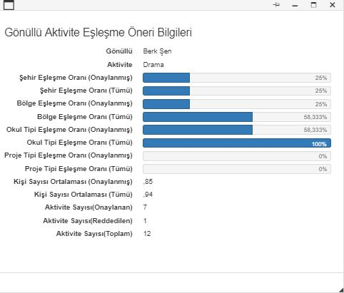
INTELLIGENCE APPLICATIONS (Volunteer Suggestion)
The match ratio between the current project’s city info and all of approved activity applications’ city info that current volunteer applied.
If the ratio is less than 1, it means the current project includes less people based on average number of people where the previous results and vice versa. The closeness to 1 is beneficial.
The match ratio between the current project’s city info and all of activity applications’ city info that current volunteer applied.
The average number of people of applied and approved activity applications.

Slide 19

GAMIFICATION
Provided by analyzing project evaluations,
Courages participants to take part in projects,
Supports volunteers and project managers to perform better to earn badges.

Slide 20


BADGES OF PROJECT MANAGER
The badge of “En İyi Proje Yöneticisi” is given to the Project Manager who takes more than three points on average in the surveys for each survey question at the end of each project detail.
The badge of “Bronz Proje Yöneticisi” is given to the Project Manager who takes “En İyi Proje Yöneticisi” badge between 3 times (included) and 7 times.
Similarly, “Gümüş Proje Yöneticisi” is given to the Project Manager who takes “En İyi Proje Yöneticisi” badge between 7 times (included) and 12 times.
Finally, “Altın Proje Yöneticisi” is given to the Project Manager who takes “En İyi Proje Yöneticisi” badge more than 12 times (included).

Slide 21

BADGES OF VOLUNTEER
The “Etkinlik Lideri” badge is given to the volunteer who gains the highest score per project detail.
The “Arı Rozeti” badge is given to the volunteer who attends maximum number of projects.
A volunteer can earn “Etkinlik Dehası” badge when the average of activity evaluation score is more than 4 out of 5.

Slide 22

BADGES OF VOLUNTEER
The badge of “Bronz Lider” is given to the Volunteer who takes “Etkinlik Lideri” badge between 3 times (included) and 7 times.
Similarly, “Gümüş Lider” is given to the Volunteer who takes “Etkinlik Lideri” badge between 7 times (included) and 12 times.
Finally, “Altın Lider” is given to the Volunteer who takes “Etkinlik Lideri” badge more than 12 times (included).

Slide 23
TEST CASES
TC_ID | PRJ.UPD_PRJ_BUT.01
Purpose | Enter the information to be updated and be sure that the fields are saved correctly.
Requirements | 3.4.2.1.7
Priority | Medium
Estimated Time Needed | 2 Minute
Dependency | Required fields should be entered.
Setup | Any project should be created.
Procedure | [A01] Go to update project page.
 | [A02] Enter information that are necessary to update a project.
 | [A03] Click on the “Güncelle” button.
 | [V01] Observe that the operation is successful and the approve message is seen.
 | -
 | -
Cleanup | Refresh page

Slide 24
ENVIRONMENT
Windows MeisterTask application for Scrum Methodology Management,
Microsoft Operating System,
Visual Studio 2018,
ASP.NET Web Forms,
Web APIs (RESTful service),
Bootstrap,
C# Programming Language,
Telerik/Kendo UI,
Team Foundation Server (TFS)
SQL Server 2018,
Entity Framework.

Slide 25
FUTURE WORKS
Financial tool can be added to handle donations.
To run the online payment system appropriately the bank API can be implemented.
To improve project planning module, routing and shortest path algorithms should be implemented to the system to determine the best route for outgoing projects.
A new interface can be added to allow users to change intelligence parameters without handling the code.
More generic system should be developed, so different NGOs would be able to use it for performing their management issues

Slide 26
CONCLUSION
The database was created by considering İLKYAR’s managerial structure.
While developing project, N-Tier Architecture was used due to its professionality.
An intelligent system was developed for the project suggestion to volunteer and volunteer suggestion for project manager by using Cased Based Reasoning (CBR) .
Gamification is performed based on badge earning.
The use cases planned in Software Specifications Requirements (SRS) are tested.
Some functionalities were decided as a future work to improve the project.

Slide 27
PROJECT SUPPORTS AND PLANS
I-NGOS project has been supported by TÜBİTAK in terms of 2209-B Industry Oriented Undergraduate Thesis Support Program.
Also, we have been studying on an article to give a conference at UBMK’19 (International Conference on Computer Science and Engineering, 2019).

Slide 28
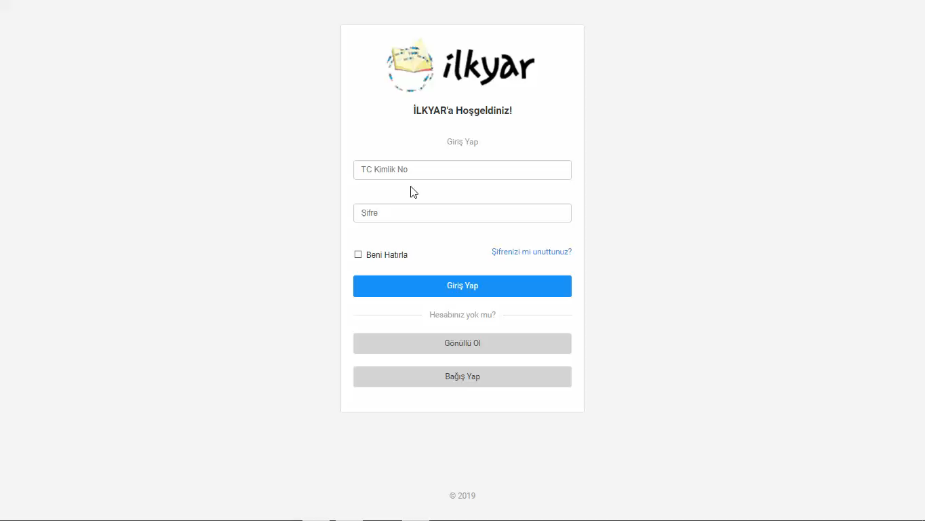
DEMO VIDEO

Slide 29

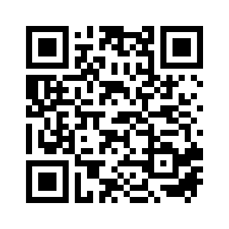
We appreciate Prof. Dr. Müslim BOZYİĞİT, Dr. Ulaş GÜLEÇ, and the case NGO İLKYAR for their assistance and support during the project.
THANK YOU FOR YOUR ATTENTION
www.ingosystems.wordpress.com

